Slide 1

“Predicting Risk of Dyslexia”
Sydney Marino
Fall 2020
Notes:
“Dyslexia is a learning disorder that involves difficulty reading due to problems identifying speech sounds and learning how they relate to letters and words “ ~ https://www.mayoclinic.org/diseases-conditions/dyslexia/symptoms-causes/syc-20353552

Slide 2
The Data
5039 Participants given a game, 32 questions, to predict if they had dyslexia or not
Originally 197 predictors, reduced to 95 due reduce redundancy and delete NULL predictors
Response variable: If the person has dyslexia (Y/N)
540 participants (12%) have dyslexia, 4,499 do not have dyslexia (88%)
Goal: Predict dyslexia among Spanish speaking students to aid them early on
Variable | Description | Possible Values
Sex | Sex of participant | M, F
Nativelang | Is Spanish the participant’s native language? | Y, N
Otherlang | Has participant failed language class at least once? | Y, N
Age | Age of participant | 7-17
Desktop_Tablet | Test conducted on tablet or desktop? | D, T
ClicksX | Total # of clicks for question X | Integer
AccuracyX | % of correct clicks for question X | 0-1
MissrateX | % of miss clicks for question X | 0-1
Notes:
Much harder to see if a student has dyslexia in Spanish speaking countries due to the grammar, spelling, etc.
Could only be told once students were failing
This study and test was created to try to predict dyslexia ahead of time to nip it early on

Slide 3
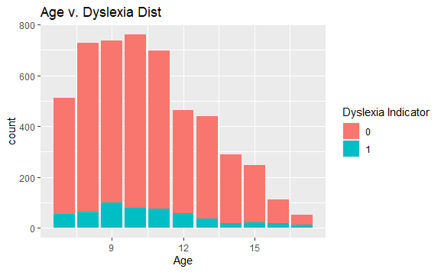
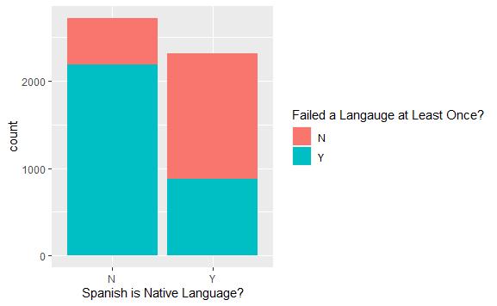
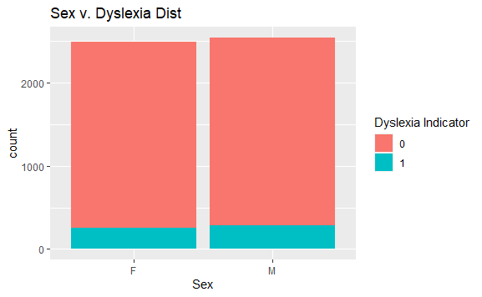
Notes:
Age is left skewed,
Sex is even
Native Lang is slightly more “N”, and more likely to fail a language (some type of interaction possibly?)

Slide 4
Models
4 Models were created: (1) Lasso, (2) Ridge, (3) Elastic, (4) Random Forest
GLM models
Binomial, cv 10, 50 different test/train combinations
Random Forest
Ntree = 500, mtry = p/3, 50 different test/train combinations
Models | Fitting Time (Train/Test) | Fitting Time (Full Data) | AUC for All Data | 90% CI AUC
Lasso | 7.13 | 8.80 | .8472 | 0.8207814, 0.8221305
Ridge | 5.52 | 9.23 | .8482 | 0.8207277, 0.8220673
Elastic | 7.23 | 6.45 | .8473 | 0.8206256, 0.8219711
Random Forest | 11.13 | 12.57 | .8248 | 0.8302181, 0.8316996
Notes:
RF slowest, better CI, but for AUC for all data is lowest

Slide 5
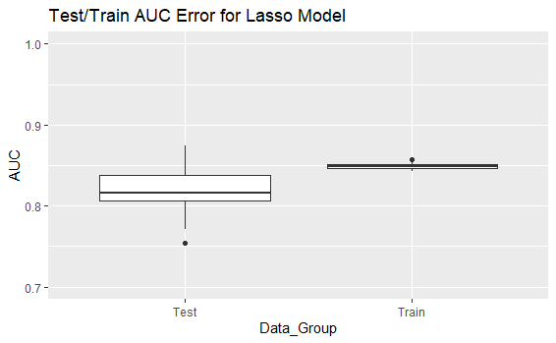
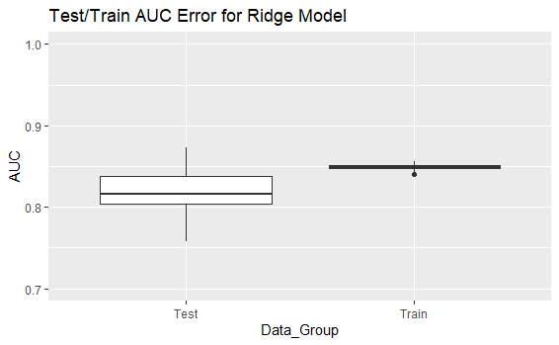
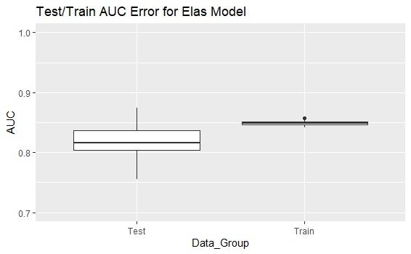
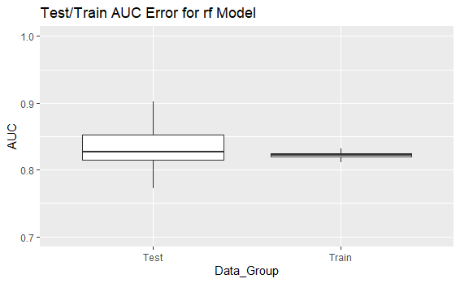
Model Analysis – AUC of 50 Samples
Notes:
Train AUC is higher for Lasso/Ridge/Elas
RF test train AUC on par with eachother

Slide 6
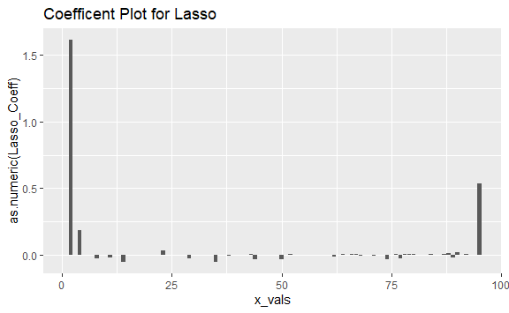
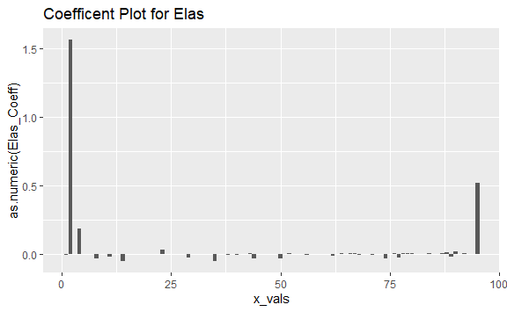

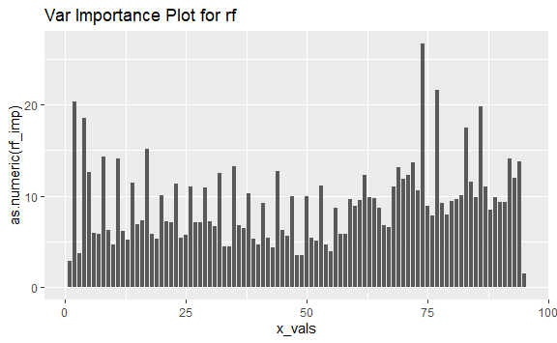
Model Analysis – Importance/Coefficients
Feature | Imp Value | Ranking
Nativelang | 1.61E+00 | 1
Desktop_Tablet | 5.33E-01 | 2
Age | 1.88E-01 | 3
Clicks4 | 5.55E-02 | 4
Clicks11 | 5.00E-02 | 5
Feature | Imp Value | Ranking
Nativelang | 1.56E+00 | 1
Desktop_Tablet | 5.16E-01 | 2
Age | 1.86E-01 | 3
Clicks4 | 5.38E-02 | 4
Clicks11 | 4.85E-02 | 5
Feature | Imp Value | Ranking
Nativelang | 1.44E+00 | 1
Desktop_Tablet | 4.66E-01 | 2
Age | 1.92E-01 | 3
Otherlang | 6.91E-02 | 4
Sex | 5.35E-02 | 5
Feature | Imp Value | Ranking
Clicks24 | 26.699014 | 1
Clicks25 | 21.588859 | 2
Nativelang | 20.338603 | 3
Clicks28 | 19.817859 | 4
Age | 18.584801 | 5
Notes:
Lasso/Ridge/Elas similar in ranking, doesn’t seem to like most variables
RF uses most and forces more on the exam rather than demographics

Slide 7
Conclusion
Lasso/Ridge/Elastic
Focuses more on demographic information, not the actual exam
Doesn’t use a lot of features
AUC isn’t bad, but may show signs of overfitting
Random Forest is the preferred model
Uses more features
Better AUC for both test and train data
Takes a bit more time, but computing time isn’t that awful
Suggests non-linear relationship
Future Considerations
More test subjects
Consider using balance data
More native Spanish speakers

Slide 8
Reference/Resources
Data: https://www.kaggle.com/luzrello/dyslexia
Code: https://github.com/SydneySHartman/STA9891_Dsylexia

